Slide 1
Data Visualisation on Covid-19
Chakradhar Reddy Nemalidinne

Slide 2
The Emergence of a Global Pandemic
December 2019, Wuhan, China: Trace the virus's discovery to a cluster of pneumonia cases of unknown cause.
Rapid Escalation: By January 2020, cases soared, with the virus transcending borders via international travel.
Global Health Emergency: WHO declared COVID-19 a Public Health Emergency on January 30, 2020.
Unprecedented Lockdowns: China implemented strict lockdowns, setting a precedent for the rest of the world.
Global Spread: Despite containment efforts, COVID-19 reached over 100 countries by March 2020.
Pandemic Declaration: On March 11, 2020, COVID-19 was declared a pandemic, signifying its worldwide impact.
Immediate Effects: Global markets plunged, and countries worldwide braced for health and economic crises.

Slide 3
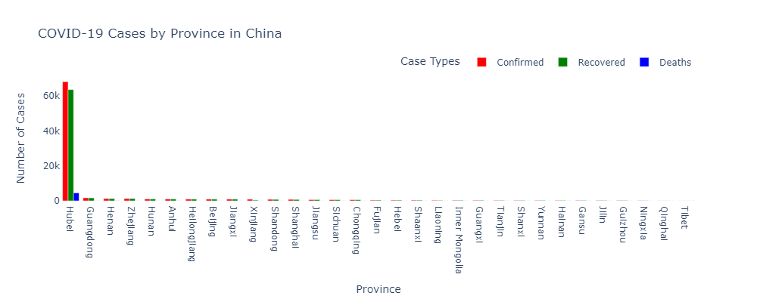
Hubei, particularly the city of Wuhan, shows the highest number of confirmed cases, which can be attributed to being the initial epicenter of the outbreak.
The rapid increase in cases was due to early exposure to the virus and delayed lockdown measures.
Population density and local health infrastructure significantly influenced the spread and management of the virus.
Provinces that reacted quickly with strict lockdowns and contact tracing managed to limit the spread more effectively.

Slide 4
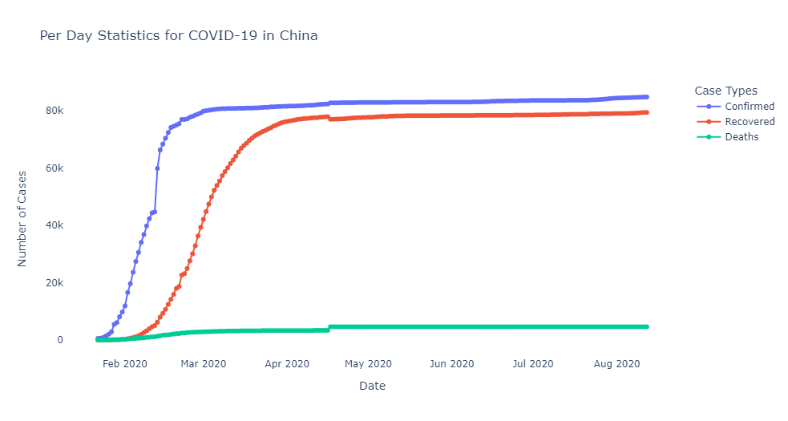
The initial exponential growth in cases underscores the virus’s high transmission rate in densely populated urban centers.
The stabilization of new cases is likely a result of stringent lockdowns, widespread testing, contact tracing, and isolation policies.
The high number of recoveries indicates the efficiency of the Chinese healthcare response in managing COVID-19 cases.
Early intervention with lockdowns in Hubei province and strict nationwide measures helped curb the spread.

Slide 5
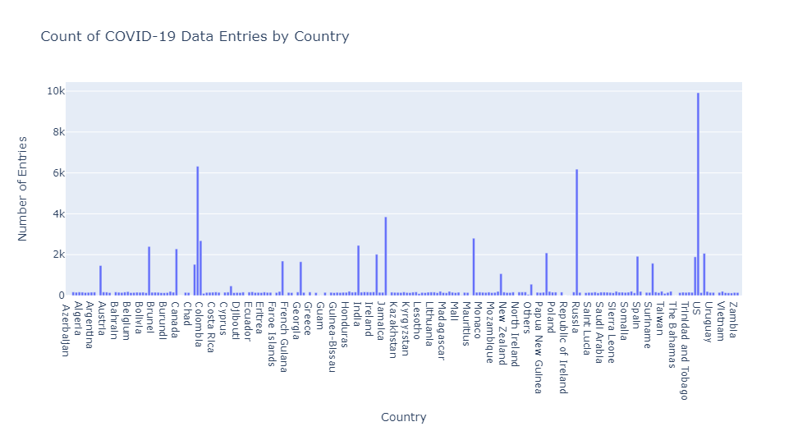
The chart shows a wide variation in the number of COVID-19 data entries across different countries, with some countries having significantly more entries than others.
The differences in entry counts could be influenced by factors such as population size, COVID-19 testing rates, reporting practices, and the overall impact of the pandemic in each country.
The country with the highest number of COVID-19 data entries is the United States, with a count of around 10,000 entries.
After the United States, the countries with the next highest number of entries are Japan, Australia, Germany, and the United Kingdom, each with entry counts around 6,000 to 8,000.

Slide 6
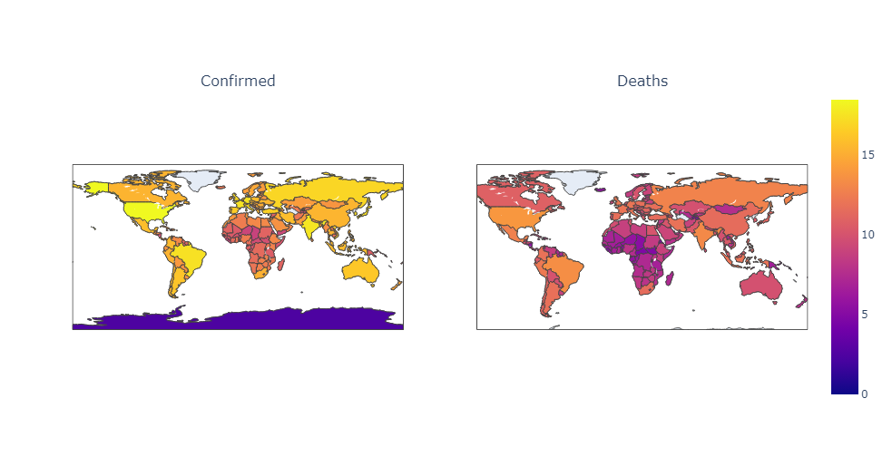
The image depicts the worldwide spread of an outbreak or phenomenon over time.
It illustrates how the situation evolved from a localized issue to a global concern.
The color scale represents the confirmed case counts in different regions.
Yellow/orange areas indicate higher case counts, while darker shades represent fewer cases.
The map can be used for continuous monitoring and tracking of the situation over time.
It allows for the evaluation of implemented measures and their effectiveness in containing the spread.

Slide 7
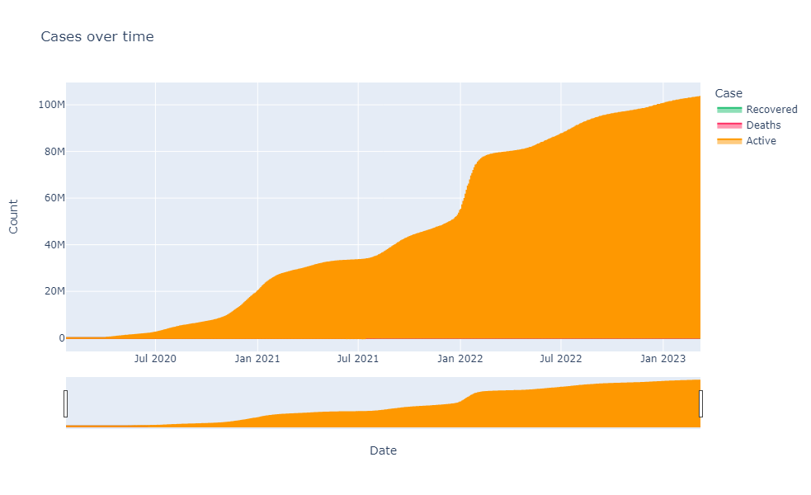
The graph illustrates a steep and rapid increase in overall case counts during the observed period.
The orange curve exhibits an exponential-like growth pattern, indicating a significant surge in cases.
The x-axis displays a timeline from July 2020 to January 2023, enabling the tracking of case progression over time.
It facilitates the identification of key inflection points or periods of accelerated growth.
The rapid growth in cases underscores the importance of proactive resource planning and preparedness measures.
The data can inform decision-making processes related to healthcare capacity, supply chains, and public health interventions.

Slide 8
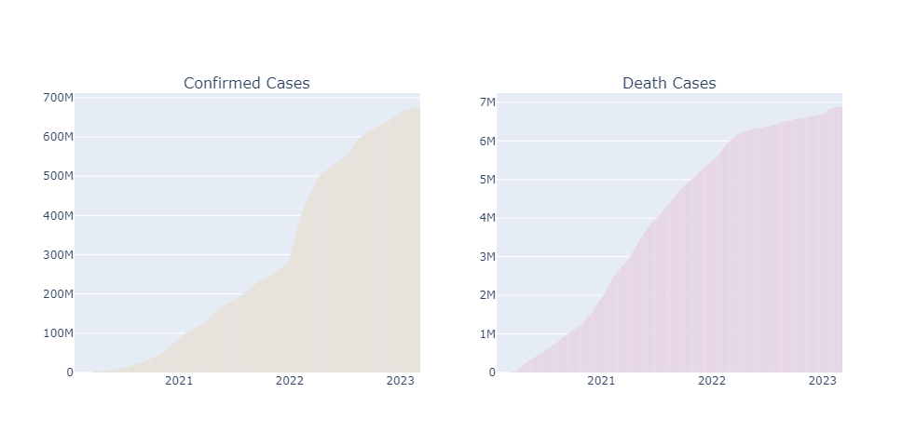
The graph on the left depicts a steep and rapidly rising curve for confirmed cases over the period from 2021 to 2023.
This trajectory suggests an accelerating outbreak or pandemic situation with a significant increase in the number of infections.
The graph on the right illustrates the trend in death cases associated with the outbreak.
While the curve is also rising, it appears to be increasing at a slower rate compared to the confirmed case curve.
The y-axis scales for the two graphs differ, with the confirmed cases graph reaching up to 700M (potentially millions) and the death cases graph up to 7M (potentially millions).
This difference in scale highlights the relatively lower number of fatalities compared to the overall confirmed cases.

Slide 9
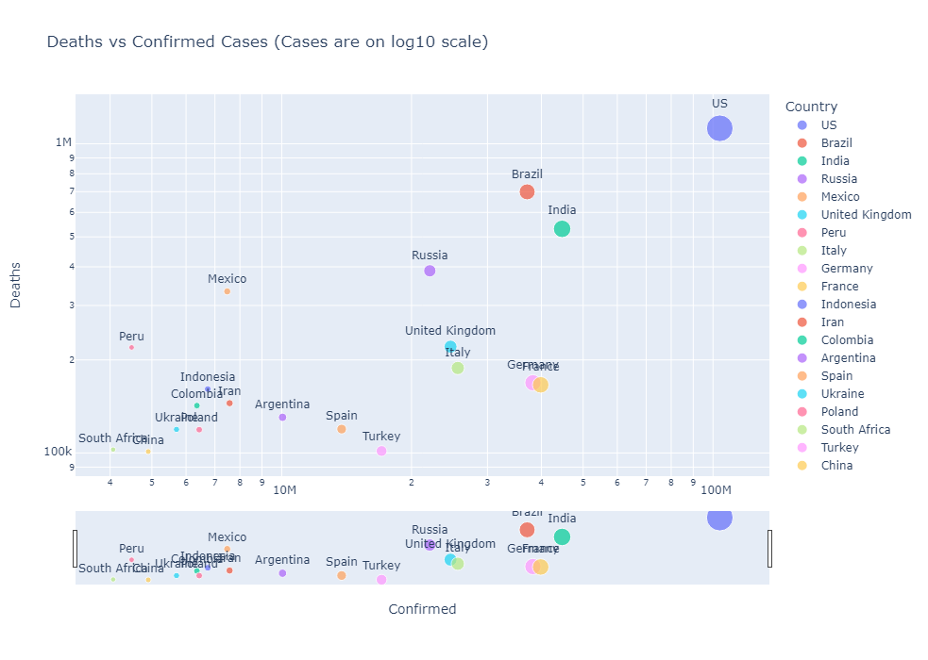
Countries like the United States, Brazil, India, and Russia appear to have experienced a relatively high number of both confirmed cases and deaths, as indicated by their positions in the upper-right region of the plot.
Some countries, such as Mexico and Peru, appear to have a higher number of deaths relative to their confirmed case counts when compared to other countries at similar case levels.
Countries like South Africa, Ukraine, Poland, and China seem to have lower confirmed case counts and fewer associated deaths, as shown by their positions in the bottom-left region of the plot.

Slide 10
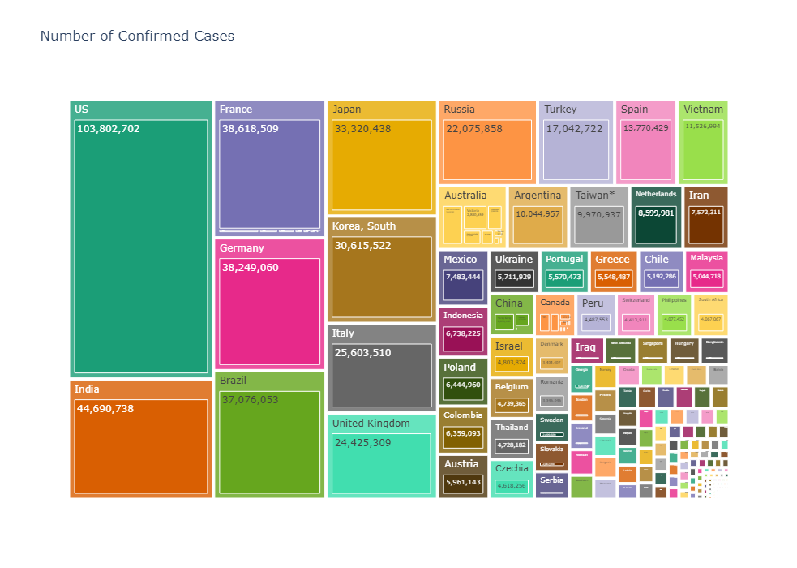
The image allows for a direct comparison of the confirmed case counts across different countries, represented by colored rectangles of varying sizes.
Countries like the United States, India, Brazil, and France appear to have experienced significantly higher numbers of confirmed cases, as indicated by their larger rectangle sizes .
While not explicitly shown, the data could be further analyzed to identify regional trends or patterns in confirmed case counts, potentially influenced by factors such as population density, public health measures, or socioeconomic factors.

Slide 11
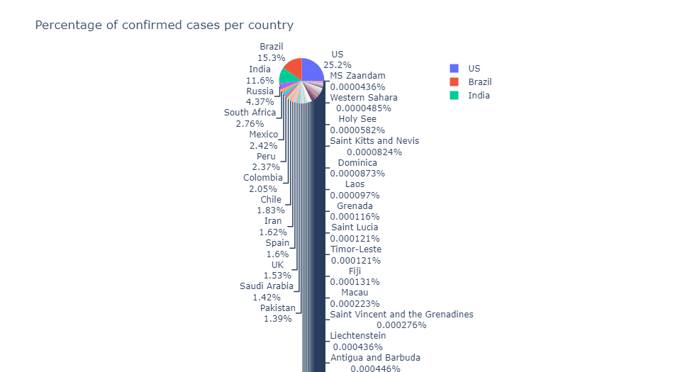
Countries with high percentages of confirmed cases face immense pressure on their healthcare systems.
Limited hospital beds, insufficient medical equipment, and a shortage of healthcare personnel characterize these strained systems.
The economic impact is most severe in countries with high percentages of cases due to lockdowns, reduced workforce, and increased healthcare spending.
Disruptions to businesses and employment can lead to significant GDP contractions, increased government debt, and long-term economic recovery challenges.

Slide 12
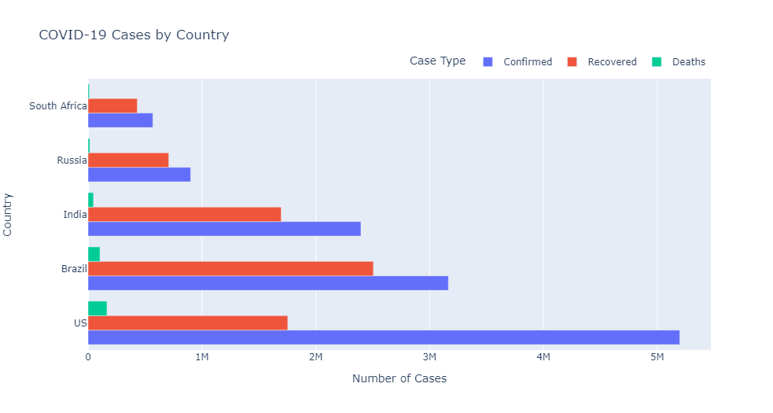
The US leads in confirmed cases, with Brazil and India following.
Recovery rates do not always correlate directly with the number of confirmed cases, as seen in the US versus Brazil.
The death tolls reflect not only the healthcare capacity but also factors such as age demographics and comorbidity prevalence.

Slide 13
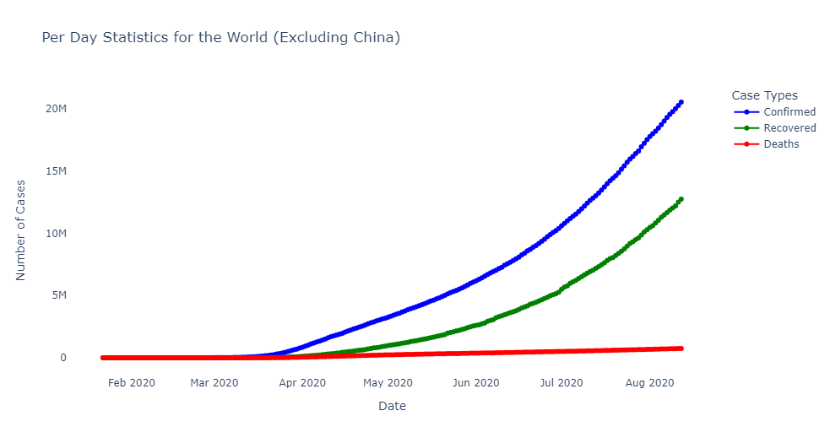
The data underscores the unprecedented scale of the health crisis faced worldwide.
Delay in global response, variability in public health measures, and initial underestimation of the virus’s transmissibility may have contributed to the increase.
The recovery curve, while also upward, lags behind confirmed cases, which may reflect the duration of illness and the time needed for recovery confirmation.
Social factors, such as population density and mobility, influenced the spread and management of cases.
Testing capacity improvements over time allowed for better tracking of the pandemic but also revealed the higher actual case numbers.

Slide 14
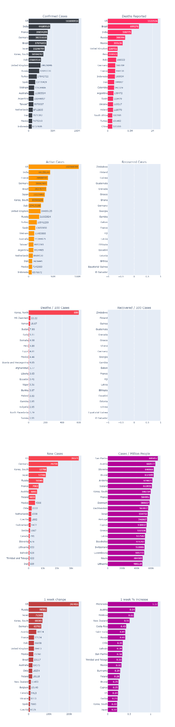
countries with more extensive testing report more cases. The US and India have ramped up testing over time.
The timing and enforcement of public health measures like lockdowns and social distancing have a significant impact on case and death numbers .
The US leads in reported deaths, which could be attributed to various factors, including the prevalence of comorbidities and healthcare system challenges .
Brazil's death toll stands out, underscoring the severe health impact in the region, possibly exacerbated by delayed containment measures .
Despite a high number of confirmed cases, India's reported deaths are comparatively lower, which may point to demographic factors such as a younger population.

Slide 15
Key Takeaways
International collaboration is paramount for managing global health emergencies.
Real-time data sharing and transparency between nations can save lives and prevent widespread transmission.
Preparedness is key; investing in healthcare infrastructure and emergency planning is non-negotiable for future crises.
The pandemic highlighted the importance of quick, science-based action and the dangers of misinformation.
Vaccine development and distribution success stories demonstrate what global cooperation can achieve.
Continued vigilance in monitoring virus mutations and maintaining public health measures is essential even as vaccination rates increase.

Slide 16
THANK YOU

